Slide 1

Orientation 2020-2021
Whole Student. Whole School.

Slide 2


Today’s Agenda
Introduction and Welcome Remarks
- Frazier Schulman, PCW President
Empowering PCW Reps and PA Presidents to Help Their Schools Take Advantage of PCW Membership
- Julie Buchanan, PCW Board Member & Orientation Co-Chair
The Good News About Bad Behavior: Why Kids Are Less Disciplined Than Ever – And What To Do About It
- Katherine Reynolds Lewis, Award-Winning Journalist, Author and Parent Educator

Slide 3
Who We Are and What We Do?
WHO WE ARE – PCW is a non-profit membership organization founded in 1964 to promote excellence in education and foster communication for independent school communities in the greater Washington, D.C. area.
WHO WE SERVE – Over 50 dues paying member independent schools representing 25,000+ students from PreK-12.
WHAT WE OFFER – We provide 8-10 innovative programs to our member school communities. Program summaries and multiple resources are available on our website and through our social media postings.

Slide 4
PCW in the 2020-2021 School Year
This year’s theme is . . .
Whole Student. Whole School.
How will this year be different from years past?
Virtual programming, at least until Spring
New programs – Winter Event, additional opportunities for PA Presidents and Parent Relations Administrators to connect
No opportunity to meet your PCW Board Member liaison in person this Fall . . . but you will hear from them via e-mail and please feel free to reach out to them anytime with questions
The program schedule is subject to change – we will all need to remain flexible this year!

Slide 5
Today’s Agenda
Introduction and Welcome Remarks
- Frazier Schulman, PCW President
Empowering PCW Reps and PA Presidents to Help Their Schools Take Advantage of PCW Membership
- Julie Buchanan, PCW Board Member & Orientation Co-Chair
The Good News About Bad Behavior: Why Kids Are Less Disciplined Than Ever – And What To Do About It
- Katherine Reynolds Lewis, Award-Winning Journalist, Author and Parent Educator

Slide 6
How To Be a Great PCW Rep
Learn About PCW/Programs
Advertise and Promote
Encourage Participation
Attend and Engage
Share Post-Event Program Materials
The “Monthly Checklist” will outline PCW Rep responsibilities each month and will include all relevant information, flyers, links, etc.

Slide 7
PCW Board Member Liaison Structure
Parent Association Presidents
Member School Communities
PCW Board Member
Liaisons*
PCW
School Representatives
School Communications Director
School Administrators
* See “2020—2021 Board Liaisons to Member Schools” handout for liaison assignments

Slide 8
2020-2021 Program Schedule
Program | Date | Time | Venue | Audience | PCW Rep Role
PCW Orientation (Katherine Reynolds Lewis) | Tuesday, Oct. 6, 2020 | 9-11:00am | Zoom | PCW Reps PA Presidents | ATTEND! Distribute Material
Movie Screening/ Moderated Discussion (Judith Warner) | Tuesday, Oct. 20, 2020 | 9-10:00am Discussion | Movies online/Zoom Miss Representation The Mask You Wear | All in Our Member School Communities | Publicize/Promote ATTEND! Distribute Material
Lower School Forum (Panel Presentations) | Tuesday, Nov. 10, 2020 | 9:30-11am | Zoom | All in our Member Lower School Communities | Publicize/Promote ATTEND! Distribute Material
Winter Event (Talking to Kids About Racism) | Thursday, Jan. 14, 2021 | 9-11:00am | TBD | All in Our Member School Communities | Publicize/Promote ATTEND! Distribute Material
Student Event (Upper School) | Tuesday, Feb. 2, 2021 | 8:30am Networking 9-12:00pm Program | Zoom | Member School Selected Students (2) | Ensure Administrator/ Counselor has date and knows to select students; Distribute Material
Student Event (Middle School) | Tuesday, Feb. 9, 2021 | 8:30am Networking 9-12:00pm Program | Zoom | Member School Selected Students (2) and School Counselor/Admin | Ensure Dean of Students has date and knows to select students; Distribute Material
Speaker Series (Ron Lieber “What to Pay for College”) | Wednesday, Feb. 10, 2021 | 7:00-8:30pm | Zoom | Everyone Welcome (even public) | Publicize/Promote ATTEND! Distribute Material
Deans’ Breakfast | Tuesday, March 9, 2021 | 8:00-10:30am Networking/Program | TBD | Upper School Deans of Students | Ensure Dean of Students has date on calendar
Parent Association Presidents’ Forum | Tuesday, May 11, 2021 | 8:30am Networking 9-11:00am Program | The Primary Day School (TBD) | Incoming and Outgoing Parent Association Presidents | Encourage school incoming and outgoing PA Presidents to attend; Distribute Material

Slide 9
Who Are These Programs For?
For Parents
Movie Screening
Lower School Forum*
Winter Event
Speaker Series
For Students
Middle School Student Leader Breakfast (MSSLB)
Upper School Student Leader Breakfast (USSLB)
For PCW Reps/PA Presidents
Orientation
Movie Screening/Moderated Discussion
Winter Event
PA Presidents’ Forum** and Summer/Fall Discussions
Informal Rep Coffees (3x/year)
For Educators
Parent Relations Summer Discussion
Movie Screening
Winter Event
Deans’ Breakfast
Lower School Forum
* Lower School Parents **Incoming & Outgoing PA Presidents

Slide 10
Important Resources
Your PCW Board Liaison
  Look for an introductory e-mail later this afternoon
Program Schedule and Month-to-Month Guide
  Outlines annual calendar and anticipated monthly PCW Rep responsibilities
Monthly Checklists
  Details specific PCW Rep action items each month
PCW Website
  https://www.parentscouncil.org/resources/resources-for-reps/
  Includes orientation materials, monthly checklists, current year program summaries and archived info from past programs

Slide 11





PCW is Active on Social Media
Please Follow and ”Like” the PCW Facebook and Twitter Pages

Slide 12
Thank You!
Any Questions?

Slide 13
Today’s Agenda
Introduction and Welcome Remarks
- Frazier Schulman, PCW President
Empowering PCW Reps and PA Presidents to Help Their Schools Take Advantage of PCW Membership
- Julie Buchanan, PCW Board Member & Orientation Co-Chair
The Good News About Bad Behavior: Why Kids Are Less Disciplined Than Ever – And What To Do About It
- Katherine Reynolds Lewis, Award-Winning Journalist, Author and Parent Educator

Slide 14

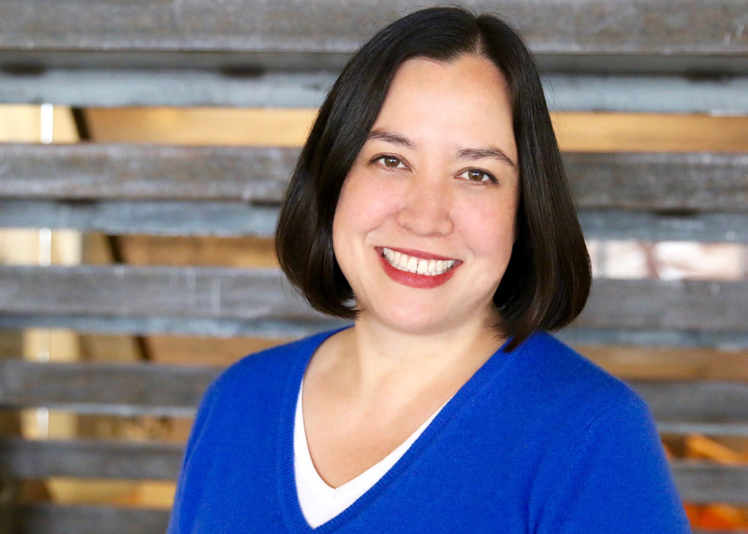
Welcome Katherine Reynolds Lewis
Award-Winning Journalist, Author and Parent Educator

