Slide 2
WELCOME
2019 Best Practices Forum
Susan Newell, PCW President
Mary Kate Blaine, Georgetown Visitation Principal
Katherine Corsico, Margaret Farrell, Susan Newell - Best Practices Forum Chairs

Slide 3
Agenda
6:00pm- 6:30pm Registration & Networking
6:30pm- 6:40pm Welcoming Remarks
6:40pm-7:50pm Panel Presentations & Takeaways
7:50pm-8:25pm Question & Answer Period
8:25pm-8:30pm Closing Remarks

Slide 4
Promoting Student Well-Being
Welcome to…
Panelists:
Corinne Fogg, Stone Ridge School of the Sacred Heart
Kiki Davis, St. Stephen’s & St. Agnes School
Heidi Greenhalgh, Georgetown Visitation Preparatory School
John Bellaschi, Landon School
Phyllis Fagell, Sheridan School
Barbara Huth, Common Sense Media

Slide 5
Corinne Fogg
Academic, Intellectual Well-Being
Director of Curriculum & Professional Development
Stone Ridge School of the Sacred Heart
Bethesda, MD

Slide 6
Academic/Intellectual Well-Being
Corinne Fogg

Slide 7
Embrace the student you have.
Kids are not one size fits all. All of our children and students are uniquely gifted, challenged, and motivated. Schools should be places where each child is embraced and celebrated as such.
There are many options for families in choosing the best school for an individual child. Finding an academic program that provides foundational skills and knowledge, in direct conjunction with a program that allows children to study what they love and be who they authentically are, is key to individual academic success.

Slide 8
Purpose over passions.
Small children insist on participating, seeking a sense of autonomy, shared responsibility, and independent purpose. In the same way, as children move through preadolescence and into adolescence and early-adulthood, they are fed by purpose. They want to be trusted and to share in the construction of the greater good in a meaningful way.
Do not be limited to subjects they’re passionate about. Academic work that bends towards having a positive social or environmental impact cultivates purpose and is essential to happiness.

Slide 9
Intrinsically motivate.
In 2016, Harvard’s Making Caring Common project shared a two-year initiative to change and better articulate the college admissions process with its “Turning the Tide” report. Culling research from over 100 colleges, “Turning the Tide” focused on promoting meaningful contributions to society via ethical engagement and redefining achievement to lessen the value of external, extrinsic accolades.
Schools can be settings where students validate their own work. Their process, their progress, and their own work should be self assessed and self affirmed.

Slide 10
Attend to your messaging.
As parents and educators, we have tremendous influence over children and students. Our messaging and branding is strong. Consider what is being validated? - the A? the growth? the college name/brand? the achievement? the struggle?
Our children are inundated by influences from social media and one another, continuously curating versions of themselves as they grow and evolve. As parents and educators, we share in this curation process. Relative to academics, our words, actions, and reactions directly inform how students self-identify. Our messaging can have positive or negative implications, as such.

Slide 11
Let ‘em drive.
Neither adults nor schools should live vicariously through children.
We are not taking Spanish; your daughter is taking Spanish.
Your son is having trouble with unit circles. You are not.
Allow for academic failure. -- I know, I know. How will they get into college? What about their grades? But let’s be realistic about what failure will look like, what the implications are, and how we can grow from a missed opportunity.
Make space for error but foster a sense of hope.

Slide 12
It’s all interconnected.
We are responsible, as adults, for realizing the interplay among physical, ethical, digital, social/emotional, cultural, and intellectual well-being.
In this, remember that we cannot give our children what we don’t have ourselves. Each of these areas of a child’s life plays into her/his success and struggle in school. Attending to these, as we disconnect our own fears from facts, pause to reflect. This enables adults to support the development of skills, the proficiency therein, and the correlation to a greater purpose such that the intellectual experience is his/her own.

Slide 13
Takeaways
Academic/Intellectual health and success will look different in and for every child. Embrace the student you have; focus on who s/he is, intentionally and explicitly seeing and celebrating her/him.
Purpose matters. A child’s sense of purpose is essential to her/his happiness and satisfaction in life. Instead of asking your children what they want to be when they grow up; ask: What problem do you seek to solve? Why are you doing this? Why does it matter to you? Seek to cultivate a sense of purpose in each child.

Slide 14
Takeaways
Cultivate intrinsic motivation. Share in activities that promote learning for learning’s sake. Practice failure; prepare children realistically for the world; prioritize ethical engagement and quality, not quantity, of activities.
Avoid “pernicious cultural messages that make us question our own instincts” as parents: “1. You have complete control over your child’s development. If you don’t, you must be doing something wrong. 2. You can never do or be enough as a parent. [and] 3. Your child’s success or failure defines you” (Simmons, R. Enough As She Is).

Slide 15
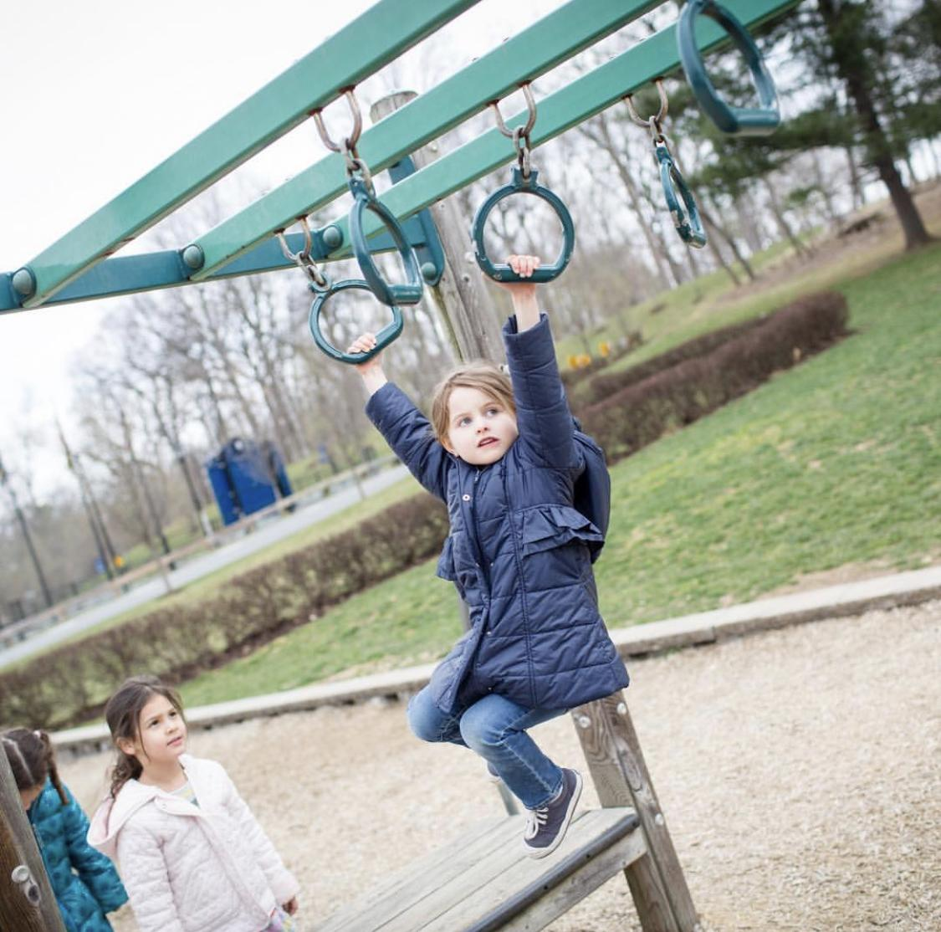
Takeaways
Let him/her drive - even when you’re scared.
We are responsible, as adults, for realizing the interplay among physical, ethical, digital, social/emotional, cultural, and intellectual well-being.

Slide 16
Takeaway Tips from Corinne Fogg
Academic/Intellectual health and success will look different in and for every child. Embrace the student you have; focus on who s/he is, intentionally and explicitly seeing and celebrating her/him. •
Purpose matters. A child’s sense of purpose is essential to her/his happiness and satisfaction in life. Instead of asking your children what they want to be when they grow up; ask: What problem do you seek to solve? Why are you doing this? Why does it matter to you? Seek to cultivate a sense of purpose in each child.
Cultivate intrinsic motivation. Share in activities that promote learning for learning’s sake. Practice failure; prepare children realistically for the world; prioritize ethical engagement and quality, not quantity, of activities.
Avoid “pernicious cultural messages that make us question our own instincts” as parents: “1. You have complete control over your child’s development. If you don’t, you must be doing something wrong. 2. You can never do or be enough as a parent. [and] 3. Your child’s success or failure defines you.” (Simmons, R., Enough As She Is)
Let him/her drive - even when you're scared.
We are responsible, as adults, for realizing the interplay among physical, ethical, digital, social/ emotional, cultural, and intellectual well-being.

Slide 17
Kiki Davis
Equity, Cultural Awareness, Global Citizenship
Director of Institutional Equity and Diversity
St. Stephen’s & St. Agnes School
Alexandria, VA

Slide 18
KiKi Davis
Director of Institutional Equity and Diversity
St. Stephen’s and St. Agnes School
kdavis@sssas.org

Slide 19
What is Equity and Inclusion?
Equality Vs. Equity
Inclusive vs. Welcoming

Slide 20
Our Mission/ Our Mandate
SSSAS Mission:
To help our students succeed in a complex and changing world, we seek to inspire a passion for learning, an enthusiasm for athletic endeavor, a striving for excellence, a celebration of diversity, a commitment to service. Our mission is to pursue goodness as well as knowledge and to honor the unique value of each of our members as a child of God in a caring community.
Strategic Plan Goal 2:
With a deep and long-standing commitment to honoring "the unique value of each of our members as a child of God in a caring community," St. Stephen's & St. Agnes School is dedicated to building and supporting a culture of diversity and inclusion. As we look to the future, diversity and equity will permeate our curriculum, programs, policies, and hiring practices. We will embrace our role as a leader in fostering a place for all, and a culture of dialogue and action around our world's most complex issues and challenges.
Action Step 2: Ensure that cultural competency skills (understanding difference, identity, perspective, diversity, and justice) are vital elements of student education and adult professional development.

Slide 21
Creating Equitable & Inclusive Community at SSSAS
Our Episcopal Identity
Policies and Practices
Training
Hiring
Gender Identity
Dress Codes
Curriculum Integration
9th grade curriculum
Colloquium for the Common Good

Slide 22
What does it mean to be Culturally Competent?
Cultural Competency is about building and maintaining relationships understanding that cultural differences exist and should not hinder our ability to successfully coexist, learn and grow as a community.
Acknowledging Differences
Understanding Identity
Examining Multiple Perspectives
Recognizing Interconnectedness
Valuing Diversity

Slide 23
Faculty & Administrator Multicultural Seminar
One day training
Seminar project
Staff Cultural Literacy Training
Coaches/Guest teachers

Slide 24
Preparing our Students
Speakers
Conferences
Leading and Attending
Forums
Student initiated/Student facilitated
Affinity Groups

Slide 25
Global Citizenship
Back to our mission:
Preparing our students for a complex a changing world
Understanding how you fit in the larger world, impacts how you feel in your smaller community
Wade Davis, Anthropologist
The world in which you were born is just one model of reality. Other cultures are not failed attempts at being you; they are unique manifestations of the human spirit.

Slide 26
Takeaway Tips from Kiki Davis
1. Being equitable is different from being equal and being inclusive is more than being welcoming.
2. Many of our schools were not created for their current demographic. In order to serve all students, it is important to re-evaluate systems and practices that may prevent us from being equitable and inclusive communities.
3. We are all responsible for a certain level of cultural awareness and literacy in order to provide students with best possible and safest experience in our institutions.
4. Cultural awareness ensures that all students are seen, valued and validated for who they are and what they bring to the community.
5. As the world gets smaller through our access to digital platforms, cultural competency becomes more important to help build and maintain relationships.

Slide 27
Heidi Greenhalgh
Physical Well-Being
School Nurse
Georgetown Visitation Preparatory School
Washington, DC

Slide 28
Promoting Physical Well-Being at
Georgetown Visitation
Heidi Greenhalgh BSN, RN, MS, CHES
School Nurse
“There is nothing so strong as gentleness and nothing so gentle as real strength”
St. Francis de Sales co-founder of the Visitation Order
Notes:
You being here is the biggest protective factor for your daughter YBSS and MHFA

Slide 29
Objectives:
How health is promoted at Visitation
Create Wellness Program
-needs assessment
-program planning
-implementation
-evaluation
Resources and Tools

Slide 30
Promoting Physical Well-Being
Helping to create habits that promote a lifetime of physical and emotional well-being
Notes:
Charectereistics that influence knowledge, attitudes and behaviors

Slide 31
Creating a Culture of Wellness at Visitation
Strength and Opportunities
Physical Activity
Physical Education class 3 trimesters
Visitation Campus
Team Sports-each season/1 no cut
Clubs-Morris Muscle, Yoga, Rugby, ice hockey
Dance Ensemble
Zumba Fundraisers
Georgetown Neighborhood
Notes:
Do the physical activity pill example
Guideines 60 min
1 in 10 eat vegetables
Harvard culinary school FREE
Course…..
Sleep stats
Cdc,WHO, HHSA, USDA
Obeesity stat
Clubs goal for the year-3 objectives for each trimester

Slide 32
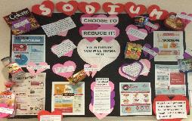
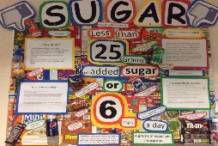
Creating a Culture of Wellness at Visitation
Strength and Opportunities
Nutrition
Visi Women’s Heart Health Club
Visi Health Club
Vegan Club
Choosemyplate.gov
Mindful eating
Dieting should not be considered normal adolescent behavior-MHFA-p77
Notes:
Do the physical activity pill example
Guideines 60 min
1 in 10 eat vegetables
Harvard culinary school FREE
Course…..
Sleep stats
Cdc,WHO, HHSA, USDA
Obeesity stat
Clubs goal for the year-3 objectives for each trimester

Slide 33
Creating a Culture of Wellness at Visitation
Strength and Opportunities
Contemplative Practices/Stress Management
Mindfulschools.org curriculum
Youth Mental Health First Aid
Apps-headspace, stopthinkbreathe
Little Virtues/Salesian Center
Therapy Dogs
Notes:
Do the physical activity pill example
Guideines 60 min
1 in 10 eat vegetables
Harvard culinary school FREE
Course…..
Sleep stats
Cdc,WHO, HHSA, USDA
Obeesity stat
Clubs goal for the year-3 objectives for each trimester

Slide 34
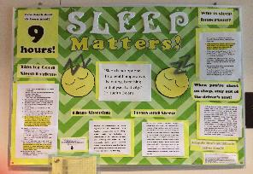
Creating a Culture of Wellness at Visitation
Strength and Opportunities
Sleep
Wellness/counseling
Dr. Nancy Cowdin-neuroscientist
Dean of Academics
Notes:
Do the physical activity pill example
Guideines 60 min
1 in 10 eat vegetables
Harvard culinary school FREE
Course…..
Sleep stats
Cdc,WHO, HHSA, USDA
Obeesity stat
Clubs goal for the year-3 objectives for each trimester

Slide 35
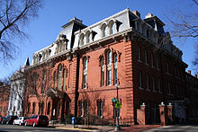
Creating a Culture of Wellness at Visitation
Workplace Wellness Committee
Yoga Class
20 minute lunchtime walks
Visi Spring Step Challenge
Blood Pressure Checks
Healthy Potluck
Healthy Happy Hour
Notes:
Goals and objectives for the club

Slide 36
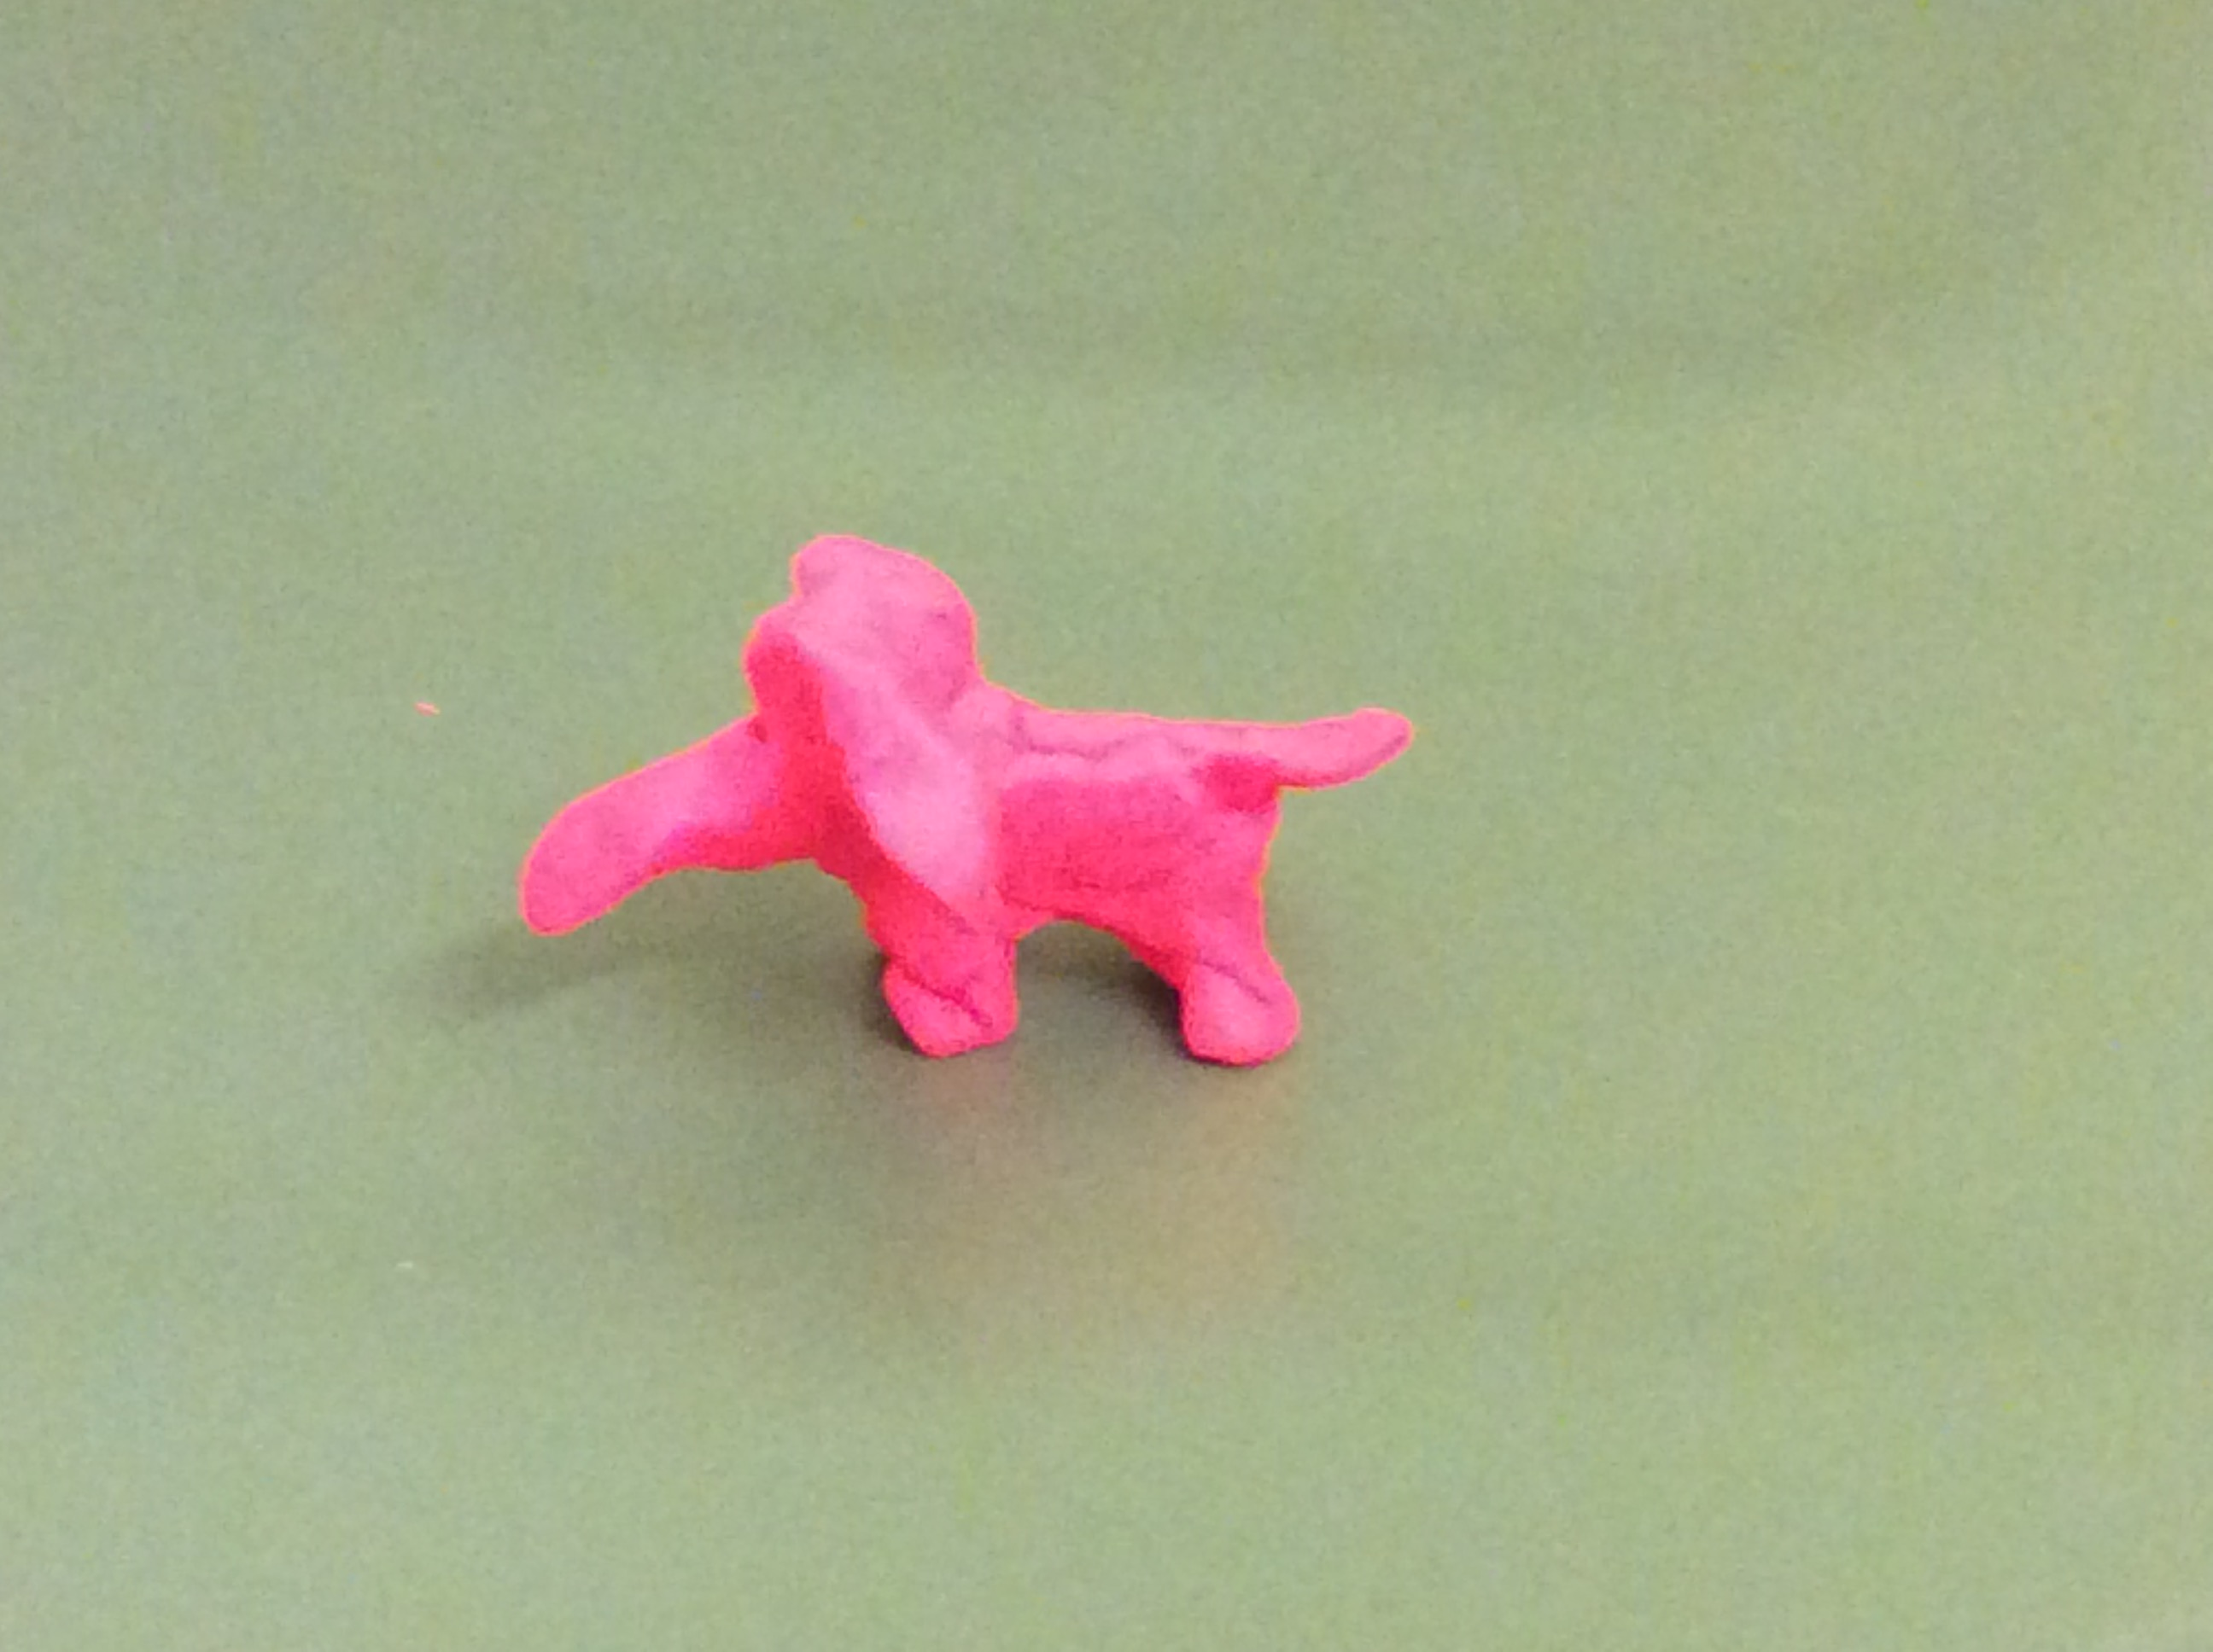
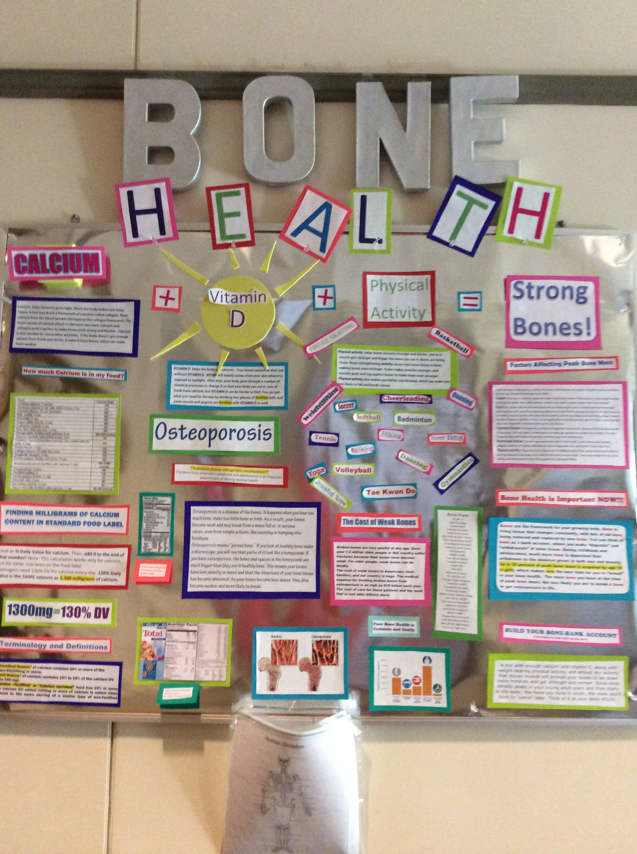
Creating a Culture of Wellness at Visitation
Weakness and Threat
Health Office Visits
Headaches
Fatigue
Menstrual Cramps
Stress/anxiety
Language- “Everybody is…….”
There’s an “epidemic”!
Half an hour's meditation each day is essential, except when you are busy. Then a full hour is needed. Saint Francis de Sales
Notes:
How to incorporate the above
MHFA

Slide 37
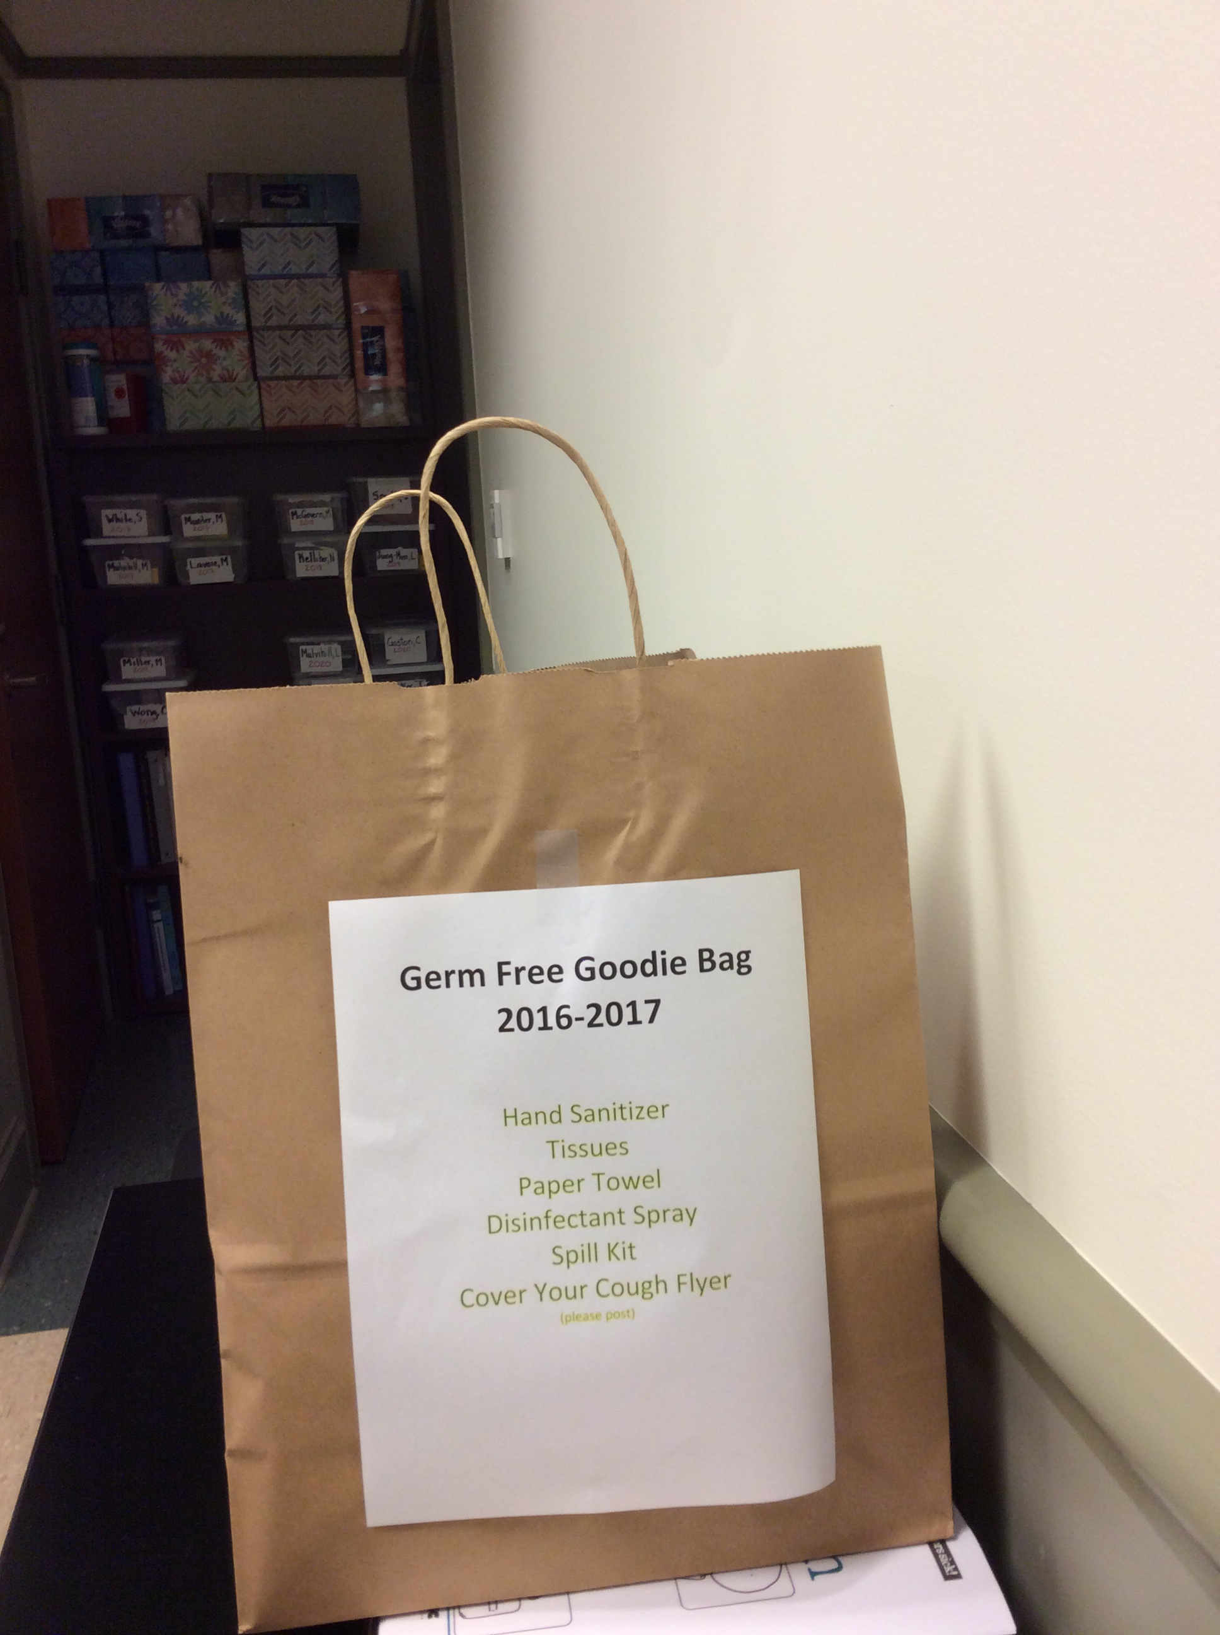
Creating a Culture of Prevention and Safety at Visitation
Weakness and Threat
Flu Prevention
Get a flu shot- CVS flu clinic
Classroom goody bags
District of Columbia Department of Health
Vaccination Compliance
Alerts From the Department of Health
Accident/Prevention –earbuds, cell phone usage, reflective gear, helmets, ect….
Notes:
Flu Stats
CDC

Slide 38
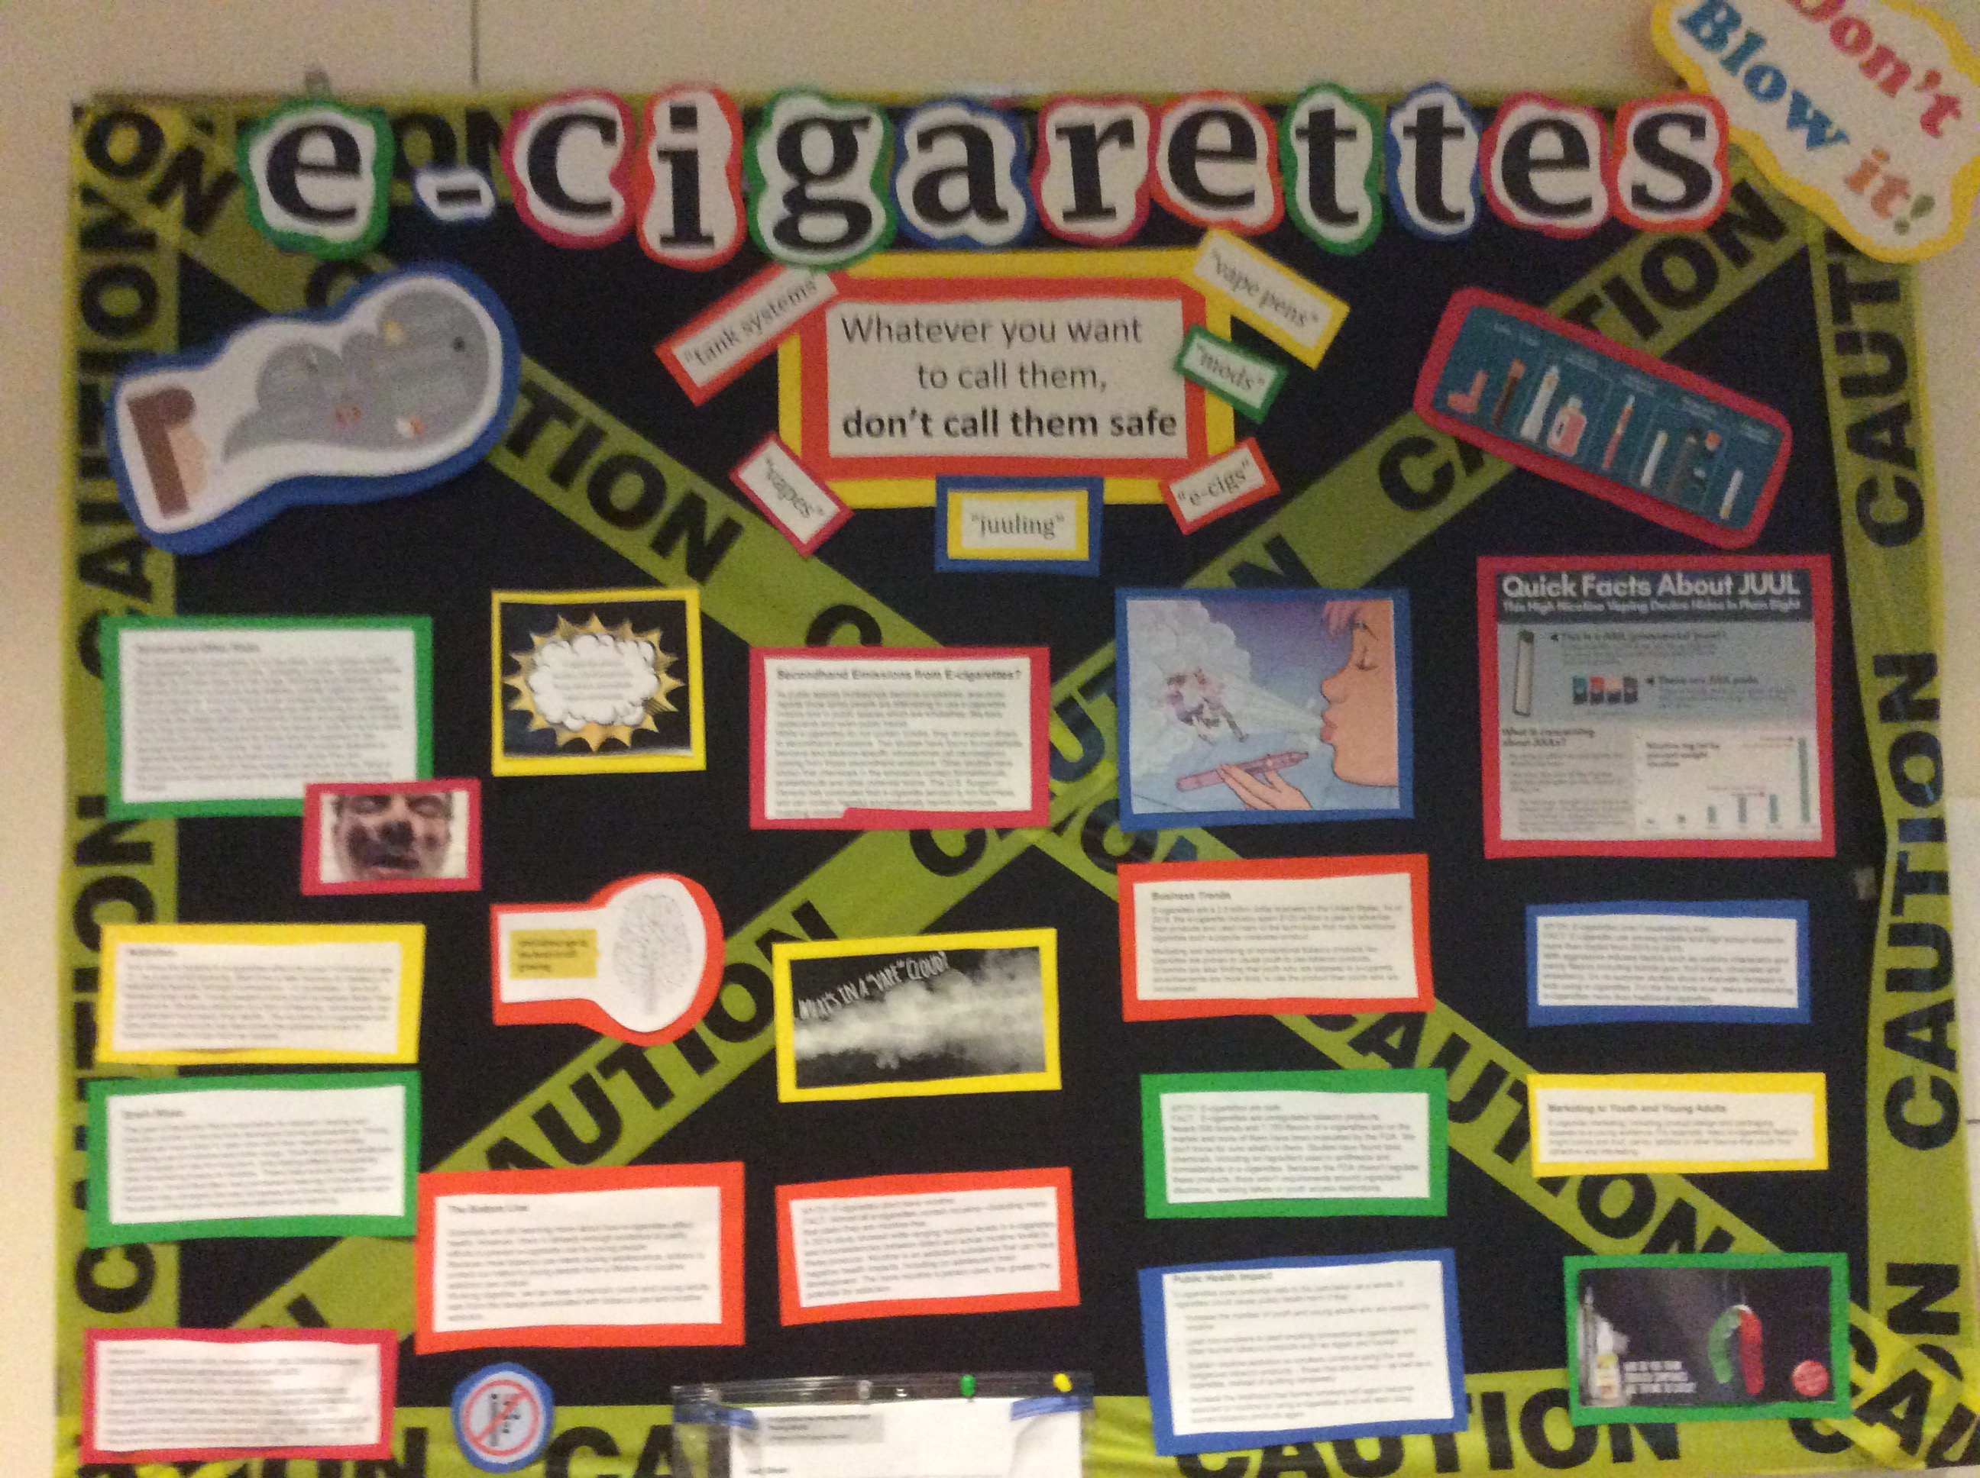
Creating a Culture of Prevention and Safety at Visitation
Threats and Weaknesses
Emphasis is on the still developing adolescent brain
Alcohol -Speaker for Freshmen, Sophomores and Parents
Vaping -Stanford Tobacco Prevention Tool Kit
Marijuana- change is laws has changed perception
Opioid- Naloxone free!
- Get rid of the prescription pain meds!!
Notes:
Language
Free stuff
SAMSHA
NIAA

Slide 39
Creating a Culture of Respect
Threats and Weaknesses
Digital Civility –Policy is written in Handbook
Relationship violence and consent-Counseling class
Bringing in the Bystander-High School Curriculum
No one can do everything but everyone can do something- Greendot
*Start having conversations with your sons and daughters about consent and physical intimacy today!

Slide 40
Program Planning
Needs Assessment
Program Planning
Implementation
Evaluation
Tools: Community Tool box and CDC SHI

Slide 41
Creating a Culture of Wellness at Visitation
Health Communication
Free!
Posters
Emails
Newsletters
School paper
Assemblies
Vidigami
Student Leaders
Government Flyers
Social media

Slide 42
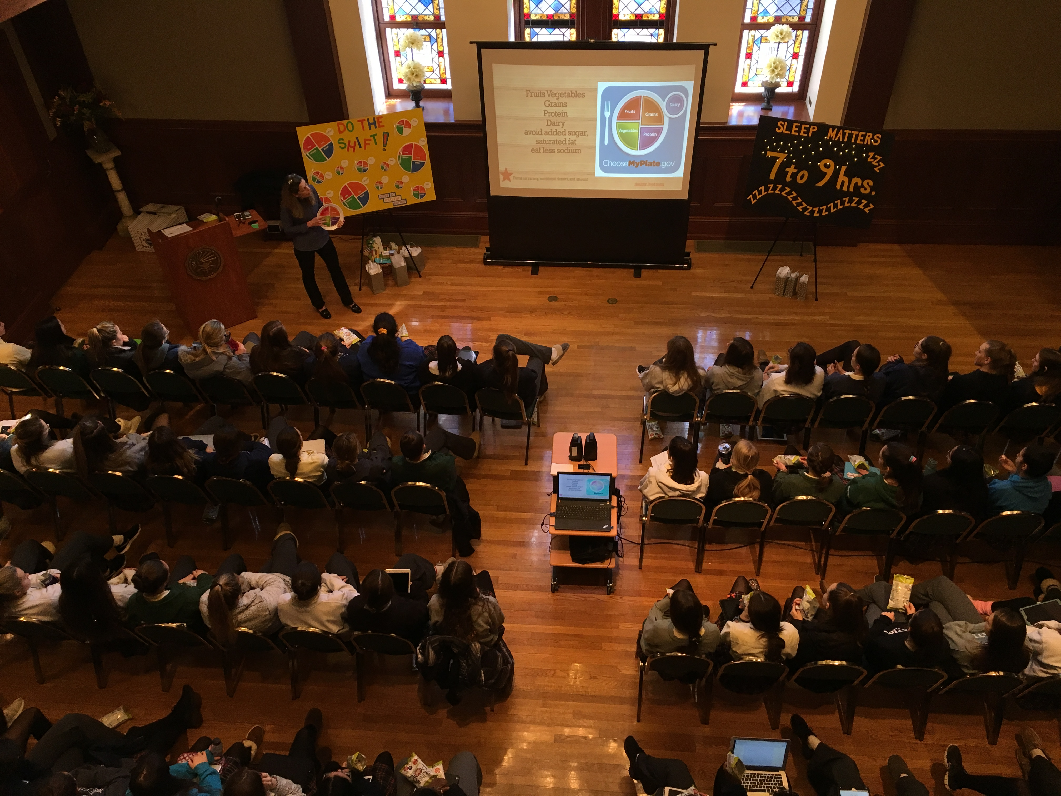
Promoting Physical Well-Being at Georgetown Visitation
Bright Futures Workshop Series
Do the Shift
Health Eating Patterns
Sleep Matters
Sleep Hygiene
Just Keep Moving
Physical Activity
Find Your Anchor
Mindfulness
No Thanks, I’m Good
Alcohol Misuse
Campus Sexual Assault

Slide 43
“Be who you are and be that WELL”
St. Francis de Sales

Slide 44
Takeaway Tips from Heidi Greenhalgh
1. Health is not just the absence of disease, it is striving for physical and mental well being and is a lifelong process of making decisions that support a balanced life and enables us to maximize potential
2. Encourage daily physical activity and healthy eating patterns
3. Emphasize good sleep hygiene is a very important health behavior
4. Help your child identify tools/techniques that help them find balance when they are stressed.
5. Have conversations with your child about consent and physical intimacy
6. Have conversations with your child about alcohol misuse and the dangers of vaping

Slide 45
Phyllis Fagell
Mental, Emotional, Social Well-Being
Counselor
Sheridan School
Washington, DC

Slide 46
Raising & Educating Emotionally
Healthy Tweens
Phyllis L. Fagell, School Counselor

Slide 47
5 Myths About Tweens: The Developmental Phase
They crave drama
They’re embarrassed by you
They don’t want to talk
They’re trying to push
your buttons
They understand that
perfection is unattainable

Slide 48
Tweens’ Lives Today
More than 25% have been a victim of electronic dating aggression, and more than 10% have been the perpetrator
Teens who post more pictures on social
media have a more negative perception of their body
Common Sense Media reported that 35% of teens
with phones admitted to cheating using the internet

Slide 49
Tweens’ Lives Today
Average age of first exposure to porn is 11
More testing, less recess, less sense of
control over their fate
29% of students report feeling stressed;
1 in 5 kids has anxiety or depression,
and the suicide rate among 10- to
14-year-olds doubled from 2007-2014

Slide 50
What Do Kids Want to Know?
“I support the idea of the #Metoo movement, but worry, ‘Am I more likely to sexually assault someone?’ How do I make sure I don’t look like a creepy guy?” -7th grade boy
“Girls can hit us all they want, but
I’d be worried about bumping my shoulder
into a girl’s chest.” -8th grade boy
“When should we start thinking about
dating? How about kissing?” -6th grade girl
“Can we boys get educated about rape?” -6th grade boy

Slide 51
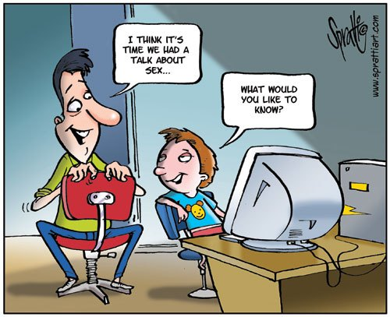
How Can Parents & Educators Help?
Identify helpers
Build a coping toolbox
Walk them through real and pretend dilemmas
Prioritize affinity groups
Instill a sense of agency
Leave time for thinking and unstructured play

Slide 52
Conversation Starters
“Is it appropriate for a ninth grader to date a seventh grader?”
“What’s the difference between physical attraction, a crush and love?”
“Why might someone be interested in a person who plays hard to get?”
“If someone asked you to send them a nude selfie,
what are some ways you could handle that?”
“What would you do if your best friend was cheating
on a boyfriend or girlfriend?”
“What are some stereotypes about boys and girls
when it comes to dating?”
“Do you think I have a good sense of what you
know about sex?”
“If you found yourself in an uncomfortable situation, what could you do?”

Slide 53
Takeaway Tips from Phyllis Fagell
Some of the most common myths about middle schoolers are that they crave drama, are trying to push adults’ buttons, and understand that perfection is unattainable. (Link to my article on this topic: Five Truths about Middle Schoolers.)
2. Tweens today are more focused on identity issues--and there are more GSA’s and other affinity groups in schools--but they also must contend with more overt racism, anti-Semitism and homophobia. They are growing up with the fallout from #Metoo, and boys are worrying about how society views them. Kids today also have less freedom and greater mental health challenges. (Link to two of my articles on this: How Childhood Has Changed for Tweens; Six Ways Parents and Schools Can Tackle the Rise in Tween Suicides.)

Slide 54
Takeaway Tips from Phyllis Fagell
3. Parents can help their child identify effective coping strategies and
vocalize when they’re using strategies themselves. They can ask their child to identify the adult they’d seek out in a crisis. They also can set aside time when tweens can just think or engage in unstructured, self-directed play.
4. To foster critical thinking and interpersonal skills, parents and educators can walk kids through real or fictional ethical or social dilemmas.
5. Schools can offer a variety of affinity groups to support kids’
emerging identities and normalize their experiences.

Slide 55
John Bellaschi
Ethics, Service, Leadership
Director of Ethics, Service and Leadership
Landon School
Bethesda, MD

Slide 56
Takeaway Tips from John Bellaschi
1. Student Well-Being Should Include ETHICAL Well-Being
Ethical well-being leads to a balanced, healthy, and meaningful life. Both students and schools flourish when they have a clearly defined ethical purpose that is nurtured.
2. It Takes A Village To Raise An Ethical Child
Yes, the African Proverb is true. Each of us (educators, parents, media, faith communities, coaches, friends, neighbors) must partner together to help our children grow ethically given certain contrary cultural forces.
3. Students Benefit Greatly From A School’s Formal Ethics Programming
Schools should set aside time and develop programs for ethics just as they do for academic disciplines (English, math, history, science, etc.).
4. Students Benefit Even More From Informal Relationships With Ethical Leaders
School administrators, teachers, coaches, and staff members as well as parents all should view themselves as ethical leaders who are committed to serve as ethical mentors and models to our students. The ethical well-being of our students depends upon these meaningful relationships.

Slide 57
Barbara Huth
Digital Well-Being
Education Program Manager
Common Sense Media
Washington, DC

Slide 58
Digital Well Being
Best Practices

Slide 59
F A C I L I T A T O R
Barbara Huth
DC Metro Education Program Manager Common Sense Education
bhuth@commonsense.org @Barbara_Huth
f: @CommonSenseEducators t: @CommonSenseEd
Notes:
\

Slide 60
BIG
PICTURE

Slide 61
All About Balance
Ask yourself - are me and/or my child:
Physically healthy and sleeping enough?
Connecting socially with family and friends (in any form)?
Engaged with and achieving in school?
Pursuing interests and hobbies (in any form)?
Having fun and learning in their use of digital media?

Slide 62
Challenges &
Practical Tips

Slide 63
Feeling Addicted & Distracted
50%
of teens feel like they are addicted to technology
Almost 1/3
Of teens with a smartphone have been woken up at night by a call, text or notification.
57 %
of teens are distracted by social media when doing homework.
42%
of teens agree that social media has taken them away from time they could spend with friends in person.

Slide 64
PRESSURE to be Connected 24/7
Constant communication
FOMO
Sneaky tech tricks
Superficial social contracts
Information overload

Slide 65
Addictive by Design
Sneaky Science Behind Persuasive Technology
1
Likes and follows
4
Snapstreaks
Feel like affirmation and give us dopamine hit
Not sending back can feel like failing a friend
2
Notifications
5
Auto-play
Little red numbers let us know there are messages waiting
Next video starts before you have time to think
3
Randomness
6
In-app purchases
Apps continuously updating means new info all the time
Spending means better features and more fun

Slide 66
Outsmart Sneaky
Science
Use these tips to help resist temptation.
Check yourself.
Turn off or limit notifications.
Set a time to check your feeds or (keep up Snapstreaks).
Turn off auto-play and in-app purchases.
Go grayscale.

Slide 69
Model
Be a media mentor and set the standard.
Monitor
Use limits, not lectures, and be up front about checking their media use.
Mediate Be ready to step in if necessary, but let teens make some choices on their own.

Slide 70
Device-Free Zones and Times

Slide 71
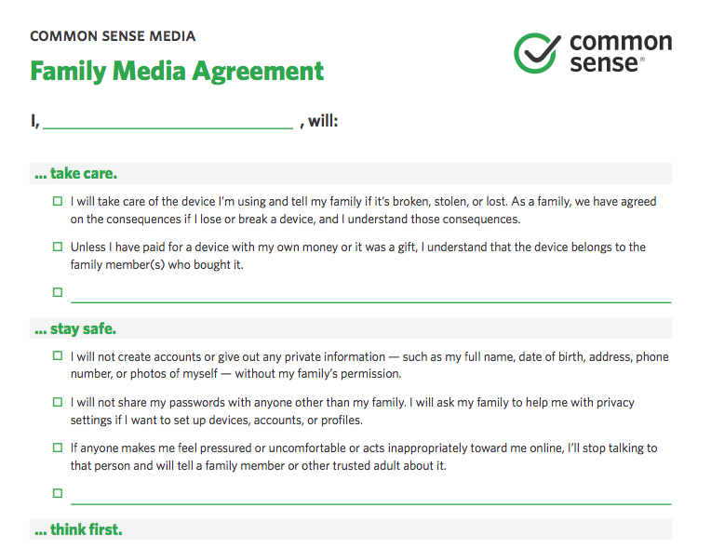

Slide 72
Parental Controls
If you decide they're necessary...
1
Identify your goals and find the right tool.
2
Set everyone up for success.
3
Troubleshoot potential hiccups.
4
Stay on the path to self-regulation.

Slide 74
Social Sharing
TEACHERS
Meaningful edtech integration
STUDENTS
Foundation of good digital citizenship
PARENTS
Supporting partnership with schools
Notes:
i

Slide 75
Social Media and Family Values
Posts we never share on social
Posts we need to ask permission
Posts that are ok to share

Slide 76
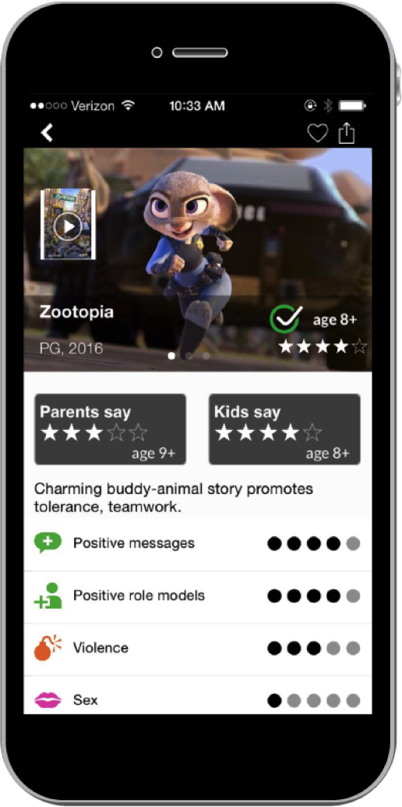
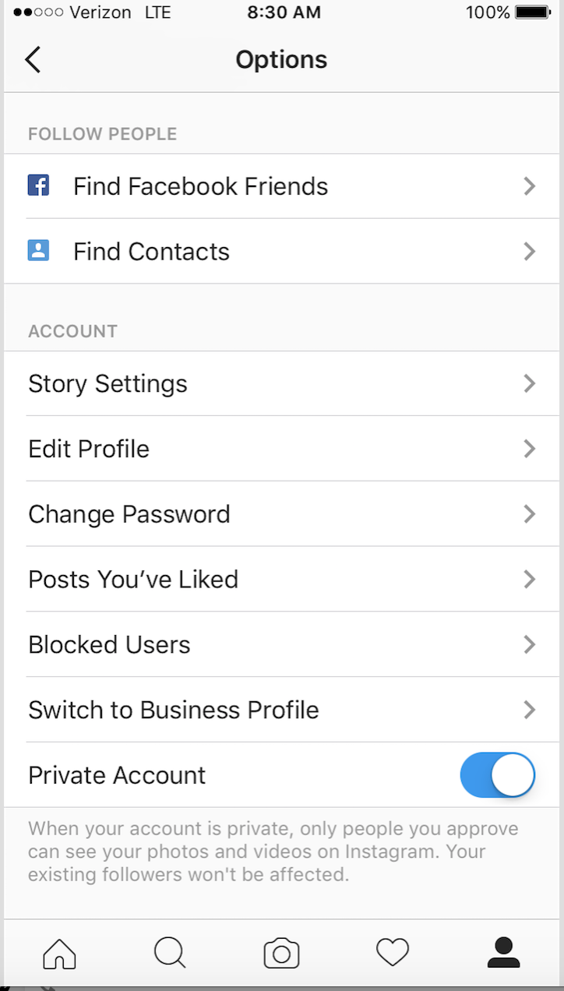
Privacy Settings

Slide 77
Social Media Red Flags
Age-inappropriate content
Public default settings
Location tracking and sharing
Real-time video streaming
Cyberbullying/negative culture
Ads and in-app purchases
“Temporary” pics and videos
Subpar reporting tools
Anonymity

Slide 78
Quick one minute videos on popular social media apps

Slide 79
Practice Digital Citizenship

Slide 80
Exposure to inappropriate content

Slide 81
Choose Help kids make good choices. Check Check what they're doing. Chat Follow up with a chat.

Slide 82
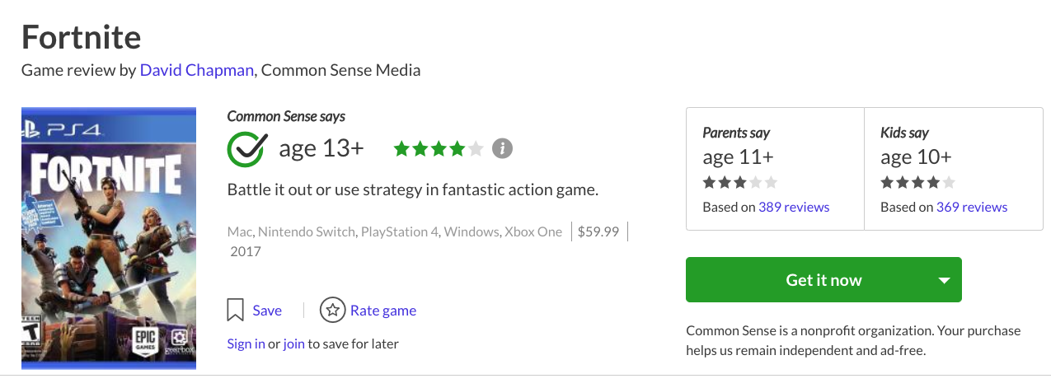
`
We Can Help!
With unbiased reviews of movies, books, apps & games so you can make informed media choices and get answers whenever you want!

Slide 83
Takeaways

Slide 84
Decide why // when // what // where // who // how
Set expectations and discuss rules together
Encourage creation as well as consumption
Model the media behavior you want to see in your teens
In settings, turn off:
Autoplay (Netflix and YouTube)
Notifications (on device and in app)
Create “sacred spaces”
Set up a timer for tech “check-ins”
Set Yourself Up For Success

Slide 85
Resources for Support
Sign up today for our tips and updates.
Tell your school about our digital citizenship curriculum.
Use Connecting Families in your community.
Contact Us
bhuth@commonsense.org
www. commonsense.org
@CommonSense
@commonsensemedia
@commonsenseorg

Slide 86
Takeaway Tips from Barbara Huth
Takeaways to Set Up Your Family For Success (in presentation)
1. Decide why // when // what // where // who // how for technology use
2. Set expectations and discuss rules together
3. Encourage creation as well as consumption
4. Model the media behavior you want to see in your kids
5. In settings, turn off:
Autoplay (Netflix, YouTube & other streaming apps)
Notifications (on device and in app)
6. Create “sacred spaces” or device free spaces at home
7. Set up a timer for tech “check-ins” to

Slide 87
Question & Answer Period

Slide 88
Thank You for Participating!
Please click on the appropriate link in your email
to fill out a short evaluation for this program.
We appreciate your feedback.

